Slide 1

IPL AUCTION
DATA ANALYSIS

Slide 2
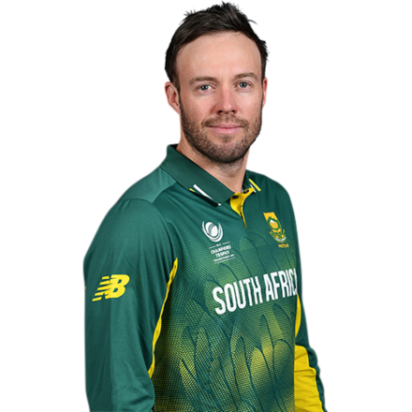
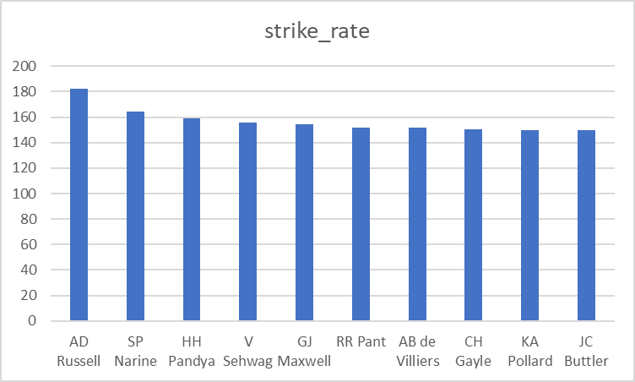
Aggressive Batters

Slide 3
Aggressive Batters (Output table)
batsman | runs_scored | balls_faced | strike_rate
AD Russell | 1517 | 832 | 182.33
SP Narine | 892 | 543 | 164.27
HH Pandya | 1349 | 847 | 159.27
V Sehwag | 2728 | 1755 | 155.44
GJ Maxwell | 1505 | 973 | 154.68
RR Pant | 2079 | 1368 | 151.97
AB de Villiers | 4849 | 3192 | 151.91
CH Gayle | 4772 | 3179 | 150.11
KA Pollard | 3023 | 2017 | 149.88
JC Buttler | 1714 | 1146 | 149.56

Slide 4

Aggressive Batters (Query)
SELECT
batsman,
SUM(batsman_runs) AS runs_scored,
COUNT(*) AS balls_faced,
ROUND(SUM(batsman_runs) * 100.0 / COUNT(*),2) AS strike_rate
FROM
IPL_Ball
WHERE
extras_type <> 'wides'
GROUP BY
batsman
HAVING
COUNT(*) >= 500
ORDER BY
strike_rate DESC
LIMIT 10;

Slide 5

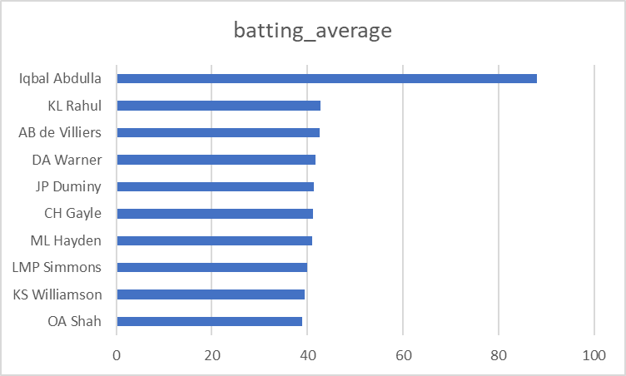
Anchor Batters

Slide 6
Anchor Batters (Output table)
batsman | total_runs | dismissals | batting_average
Iqbal Abdulla | 88 | 1 | 88
KL Rahul | 2647 | 62 | 42.69
AB de Villiers | 4849 | 114 | 42.54
DA Warner | 5254 | 126 | 41.7
JP Duminy | 2029 | 49 | 41.41
CH Gayle | 4772 | 116 | 41.14
ML Hayden | 1107 | 27 | 41
LMP Simmons | 1079 | 27 | 39.96
KS Williamson | 1619 | 41 | 39.49
OA Shah | 506 | 13 | 38.92

Slide 7
Anchor Batters (Query)
Continued……….
WITH SeasonParticipation AS (
SELECT
b.batsman,
COUNT(DISTINCT EXTRACT(YEAR FROM m.date)) AS seasons_played
FROM
IPL_Ball b
JOIN
IPL_matches m ON b.id = m.id
GROUP BY
b.batsman
),
BattingStats AS (
SELECT
b.batsman,
SUM(b.batsman_runs) AS total_runs,
COUNT(CASE WHEN b.is_wicket = 1 THEN 1 ELSE NULL END) AS dismissals
FROM
IPL_Ball b
GROUP BY
b.batsman
),
CombinedStats AS (
SELECT
sp.batsman,
sp.seasons_played,
bs.total_runs,
bs.dismissals,
round((bs.total_runs * 1.0 / bs.dismissals),2) AS batting_average
FROM
SeasonParticipation sp
JOIN
BattingStats bs ON sp.batsman = bs.batsman
WHERE
sp.seasons_played > 2 AND bs.dismissals > 0
)
SELECT
batsman,
total_runs,
dismissals,
batting_average
FROM
CombinedStats
ORDER BY
batting_average DESC
LIMIT 10;

Slide 8

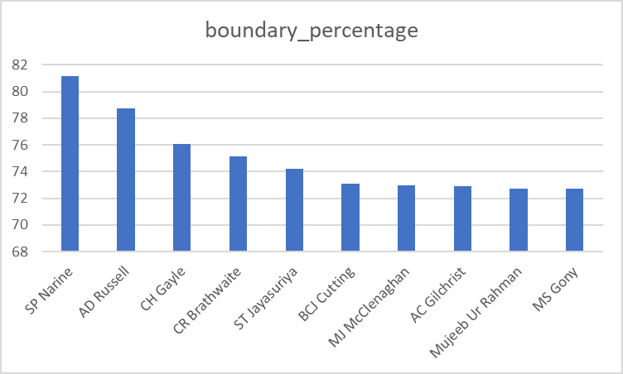
Hard hitters

Slide 9
Hard hitters (Output table)
batsman | boundary_runs | total_runs | boundary_percentage
SP Narine | 724 | 892 | 81.17
AD Russell | 1194 | 1517 | 78.71
CH Gayle | 3630 | 4772 | 76.07
CR Brathwaite | 136 | 181 | 75.14
ST Jayasuriya | 570 | 768 | 74.22
BCJ Cutting | 174 | 238 | 73.11
MJ McClenaghan | 62 | 85 | 72.94
AC Gilchrist | 1508 | 2069 | 72.89
Mujeeb Ur Rahman | 8 | 11 | 72.73
MS Gony | 72 | 99 | 72.73

Slide 10
Hard hitters(Query)
WITH PlayerBoundaryRuns AS (
SELECT
b.batsman,
SUM(CASE WHEN b.batsman_runs IN (4, 6) THEN b.batsman_runs ELSE 0 END) AS boundary_runs,
SUM(b.batsman_runs) AS total_runs
FROM
IPL_Ball b
GROUP BY
b.batsman
),
PlayerSeasons AS (
SELECT
b.batsman,
COUNT(DISTINCT EXTRACT(YEAR FROM m.date)) AS seasons_played
FROM
IPL_Ball b
JOIN
IPL_matches m ON b.id = m.id
GROUP BY
b.batsman
HAVING
COUNT(DISTINCT EXTRACT(YEAR FROM m.date)) > 2
),
Continued……….
HardHittingPlayers AS (
SELECT
pbr.batsman,
pbr.boundary_runs,
pbr.total_runs,
round((pbr.boundary_runs * 100.0 / pbr.total_runs),2) AS boundary_percentage
FROM
PlayerBoundaryRuns pbr
JOIN
PlayerSeasons ps ON pbr.batsman = ps.batsman
)
SELECT
batsman,
boundary_runs,
total_runs,
boundary_percentage
FROM
HardHittingPlayers
ORDER BY
boundary_percentage DESC
LIMIT 10;

Slide 11

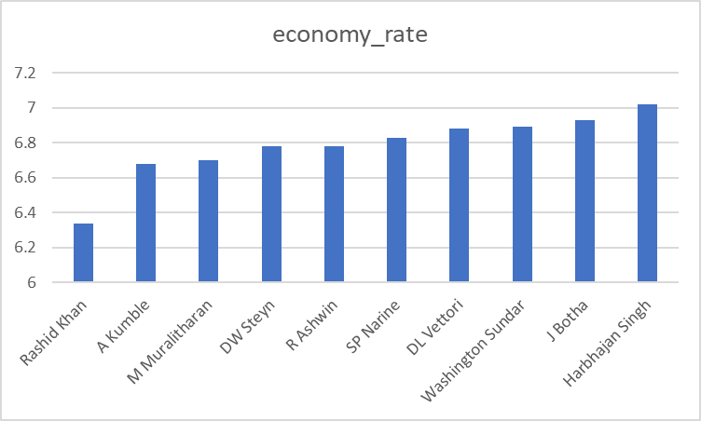
Economical bowlers

Slide 12
Economical bowlers(Output table)
bowler | balls_bowled | runs_conceded | economy_rate
Rashid Khan | 1490 | 1573 | 6.34
A Kumble | 983 | 1089 | 6.68
M Muralitharan | 1577 | 1755 | 6.7
DW Steyn | 2276 | 2568 | 6.78
R Ashwin | 3327 | 3756 | 6.78
SP Narine | 2824 | 3208 | 6.83
DL Vettori | 785 | 894 | 6.88
Washington Sundar | 660 | 758 | 6.89
J Botha | 709 | 818 | 6.93
Harbhajan Singh | 3451 | 4038 | 7.02

Slide 13
Economical bowlers (Query)
WITH BowlerStats AS (
SELECT
bowler,
COUNT(*) AS balls_bowled,
SUM(total_runs) AS runs_conceded -- Assuming total_runs includes all runs from the delivery
FROM
IPL_Ball
GROUP BY
bowler
HAVING
COUNT(*) >= 500
),
BowlerEconomy AS (
SELECT
bowler,
balls_bowled,
runs_conceded,
round((runs_conceded * 1.0 / (balls_bowled / 6)),2) AS economy_rate
FROM
BowlerStats
)
Continued……….
SELECT
bowler,
balls_bowled,
runs_conceded,
economy_rate
FROM
BowlerEconomy
ORDER BY
economy_rate ASC
LIMIT 10;

Slide 14
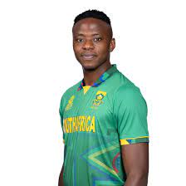
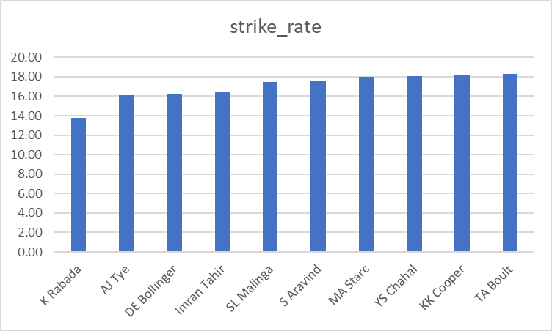
Wicket taking bowlers

Slide 15
Wicket taking bowlers (Output table)
bowler | balls_bowled | wickets_taken | strike_rate
K Rabada | 840 | 61 | 13.77
AJ Tye | 645 | 40 | 16.13
DE Bollinger | 600 | 37 | 16.22
Imran Tahir | 1314 | 80 | 16.43
SL Malinga | 2974 | 170 | 17.49
S Aravind | 788 | 45 | 17.51
MA Starc | 612 | 34 | 18.00
YS Chahal | 2188 | 121 | 18.08
KK Cooper | 600 | 33 | 18.18
TA Boult | 1152 | 63 | 18.29

Slide 16
Wicket taking bowlers (Query)
WITH BowlerPerformance AS (
SELECT
bowler,
COUNT(*) AS balls_bowled, -- Total balls bowled by each bowler
SUM(CASE WHEN is_wicket = 1 AND dismissal_kind NOT IN ('run out', 'retired hurt', 'obstructing the field') THEN 1 ELSE 0 END) AS wickets_taken -- Counting legitimate bowler wickets
FROM
IPL_Ball
GROUP BY
bowler
HAVING
COUNT(*) >= 500 -- Bowlers who have bowled at least 500 balls
),
BowlerStrikeRate AS (
SELECT
bowler,
balls_bowled,
wickets_taken,
(balls_bowled * 1.0 / NULLIF(wickets_taken, 0)) AS strike_rate -- Calculating strike rate
FROM
BowlerPerformance
)
Continued……….
SELECT
bowler,
balls_bowled,
wickets_taken,
strike_rate
FROM
BowlerStrikeRate
ORDER BY
strike_rate ASC -- Lower strike rate is better
LIMIT 10;

Slide 17
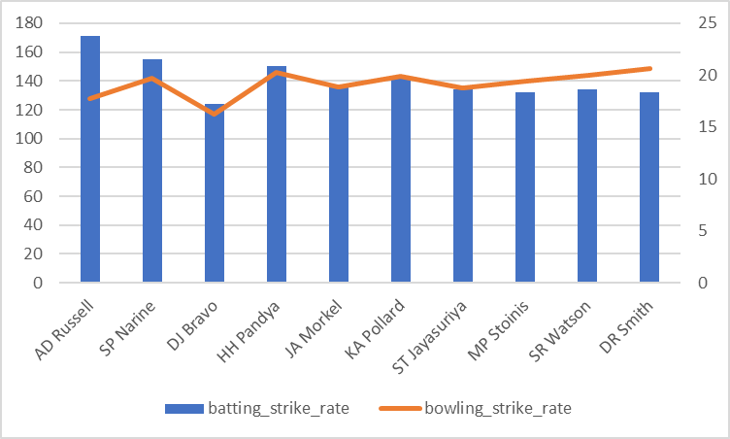

All Rounder

Slide 18
All Rounder
player | batting_strike_rate | bowling_strike_rate
AD Russell | 171 | 17.70149
SP Narine | 155 | 19.74825
DJ Bravo | 124 | 16.26286
HH Pandya | 150 | 20.31111
JA Morkel | 136 | 18.82292
KA Pollard | 143 | 19.91549
ST Jayasuriya | 134 | 18.8125
MP Stoinis | 132 | 19.37931
SR Watson | 134 | 19.97196
DR Smith | 132 | 20.62963

Slide 19
All Rounder
WITH BattingStats AS (
SELECT
batsman,
COUNT(*) AS balls_faced,
SUM(batsman_runs) AS runs_scored,
(SUM(batsman_runs) * 100 / COUNT(*)) AS batting_strike_rate
FROM
IPL_Ball
GROUP BY
batsman
HAVING
COUNT(*) >= 500
),
BowlingStats AS (
SELECT
bowler,
COUNT(*) AS balls_bowled,
SUM(CASE WHEN is_wicket = 1 AND dismissal_kind NOT IN ('run out', 'retired hurt', 'obstructing the field') THEN 1 ELSE 0 END) AS wickets_taken,
(COUNT(*) * 1.0 / NULLIF(SUM(CASE WHEN is_wicket = 1 THEN 1 ELSE 0 END), 0)) AS bowling_strike_rate
FROM
IPL_Ball
GROUP BY
bowler
HAVING
COUNT(*) >= 300
),
Continued……….
AllRounderPerformance AS (
SELECT
bs.batsman AS player,
bs.batting_strike_rate,
bw.bowling_strike_rate
FROM
BattingStats bs
JOIN
BowlingStats bw ON bs.batsman = bw.bowler
)
SELECT
player,
batting_strike_rate,
bowling_strike_rate
FROM
AllRounderPerformance
ORDER BY
(batting_strike_rate / bowling_strike_rate) DESC
LIMIT 10;

Slide 20
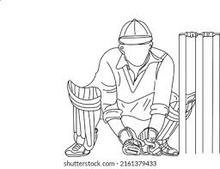
Wicket keeper (criteria)
Catches and Stumpings: High numbers of catches and stumpings are indicative of a wicketkeeper's skill and reaction time. Prioritize wicketkeepers with a high rate of dismissals per game, as this reflects their ability to take advantage of any opportunity to remove a batsman.
Strike Rate: Given the T20 format's emphasis on scoring quickly, a wicketkeeper with a high strike rate can significantly impact the game's momentum and team's total score.

Slide 21

Additional Questions (Table creation : Deliveries)
CREATE TABLE Deliveries (
id INT,
inning INT,
over INT,
ball INT,
batsman VARCHAR(255),
non_striker VARCHAR(255),
bowler VARCHAR(255),
batsman_runs INT,
extra_runs INT,
total_runs INT,
is_wicket INT,
dismissal_kind VARCHAR(255),
player_dismissed VARCHAR(255),
fielder VARCHAR(255),
extras_type VARCHAR(255),
batting_team VARCHAR(255),
bowling_team VARCHAR(255)
);

Slide 22
Additional Questions (Table creation : Matches)
CREATE TABLE Matches (
id INT PRIMARY KEY,
city VARCHAR(50),
date bowling team,
player_of_match VARCHAR(100),
venue VARCHAR(100),
neutral_venue INT,
team1 VARCHAR(100),
team2 VARCHAR(100),
toss_winner VARCHAR(100),
toss_decision VARCHAR(10),
winner VARCHAR(100),
result VARCHAR(10),
result_margin FLOAT,
eliminator CHAR(2),
method VARCHAR(10),
umpire1 VARCHAR(50),
umpire2 VARCHAR(50)
);

Slide 23

1. Total cities hosted IPL
Select Count(Distinct city)
From Matches;
There are total of 33 cities have hosted IPL so far

Slide 24
2. Create new table derived from deliveries
CREATE TABLE deliveries_v02 AS
SELECT
*,
CASE
WHEN total_runs >= 4 THEN 'boundary'
WHEN total_runs = 0 THEN 'dot'
ELSE 'other'
END AS ball_result
FROM
deliveries;

Slide 25
3. Total boundaries and dot balls
SELECT
SUM(CASE WHEN ball_result = 'boundary' THEN 1 ELSE 0 END) AS total_boundaries,
SUM(CASE WHEN ball_result = 'dot' THEN 1 ELSE 0 END) AS total_dot_balls
FROM
deliveries_v02;
total_boundaries | total_dot_balls
31468 | 67841

Slide 26
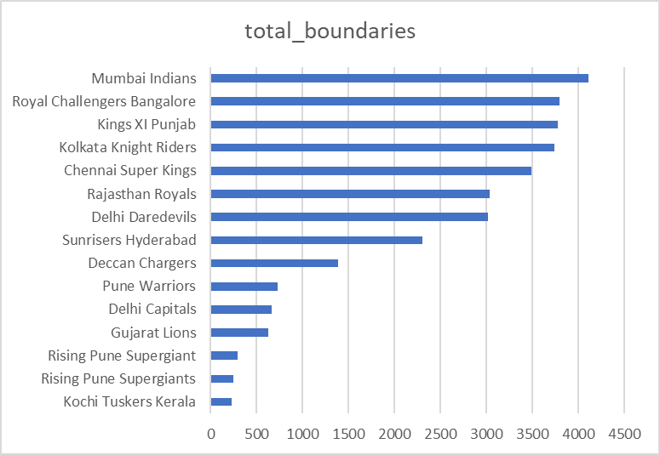
4. Total boundaries by each team
SELECT
batting_team,
COUNT(*) AS total_boundaries
FROM
deliveries_v02
WHERE
ball_result = 'boundary'
GROUP BY
batting_team
ORDER BY
total_boundaries DESC;

Slide 27
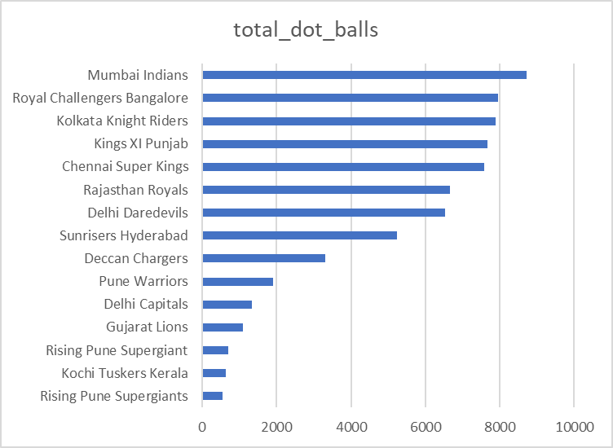
5. Total dot balls by each team
SELECT
bowling_team,
COUNT(*) AS total_dot_balls
FROM
deliveries_v02
WHERE
ball_result = 'dot'
GROUP BY
bowling_team
ORDER BY
total_dot_balls DESC;

Slide 28
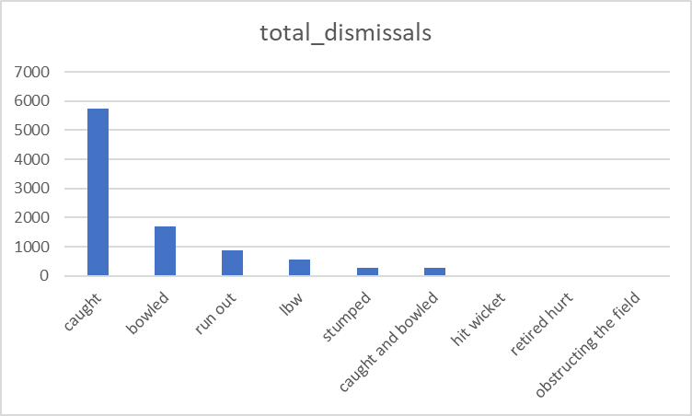
6. Total dismissals by dismissal kind
SELECT
dismissal_kind,
COUNT(*) AS total_dismissals
FROM
deliveries_v02
WHERE
dismissal_kind IS NOT NULL AND dismissal_kind != 'NA'
GROUP BY
dismissal_kind
ORDER BY
total_dismissals DESC;

Slide 29
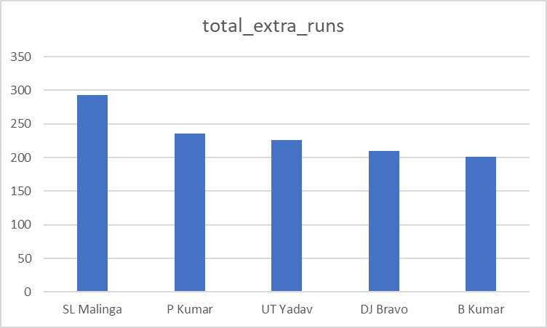
7. Top 5 bowlers conceding max extras
SELECT
bowler,
SUM(extra_runs) AS total_extra_runs
FROM
deliveries
GROUP BY
bowler
ORDER BY
total_extra_runs DESC
LIMIT 5;

Slide 30
8. Create new derived table deliveries_v03
CREATE TABLE deliveries_v03 AS
SELECT
d.*,
m.venue,
m.date AS match_date
FROM
deliveries_v02 d
JOIN
matches m ON d.id = m.id;

Slide 31
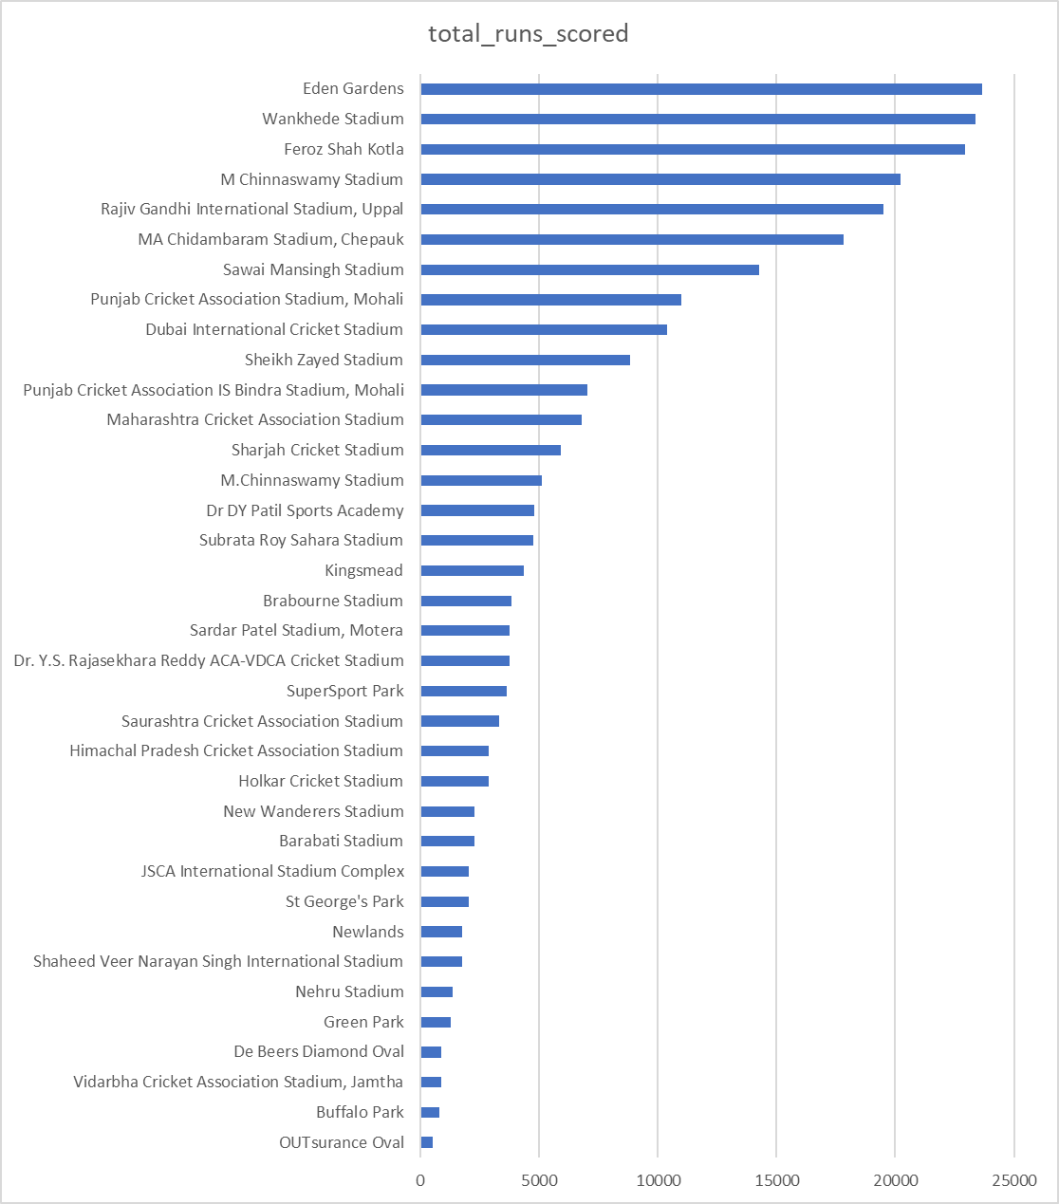
9. Total runs for each venues
SELECT
venue,
SUM(total_runs) AS total_runs_scored
FROM
deliveries_v03
GROUP BY
venue
ORDER BY
total_runs_scored DESC;

Slide 32
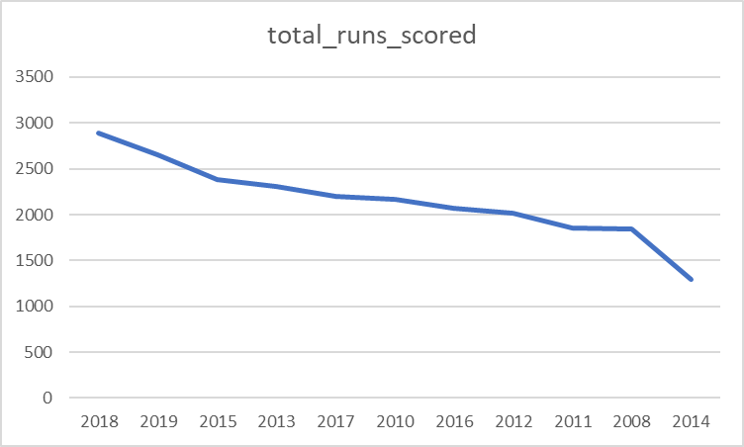
10. Year wise total scores at Eden Garden
SELECT
EXTRACT(YEAR FROM match_date) AS year,
SUM(total_runs) AS total_runs_scored
FROM
deliveries_v03
WHERE
venue = 'Eden Gardens'
GROUP BY
year
ORDER BY
total_runs_scored DESC;

